Slide 1


Youth Engagement Virtual Forum
OUR CITY. OUR FUTURE.
Parks, Trails, & Open Spaces
Arts & Culture
Active Transportation
Presented by: Youth Engagement Working Group
November 29, 2022

Slide 2
Introduction
A CONNECTED CITY
The following information was put together from staff in the 3 departments who are participating in the Forum.

Slide 3
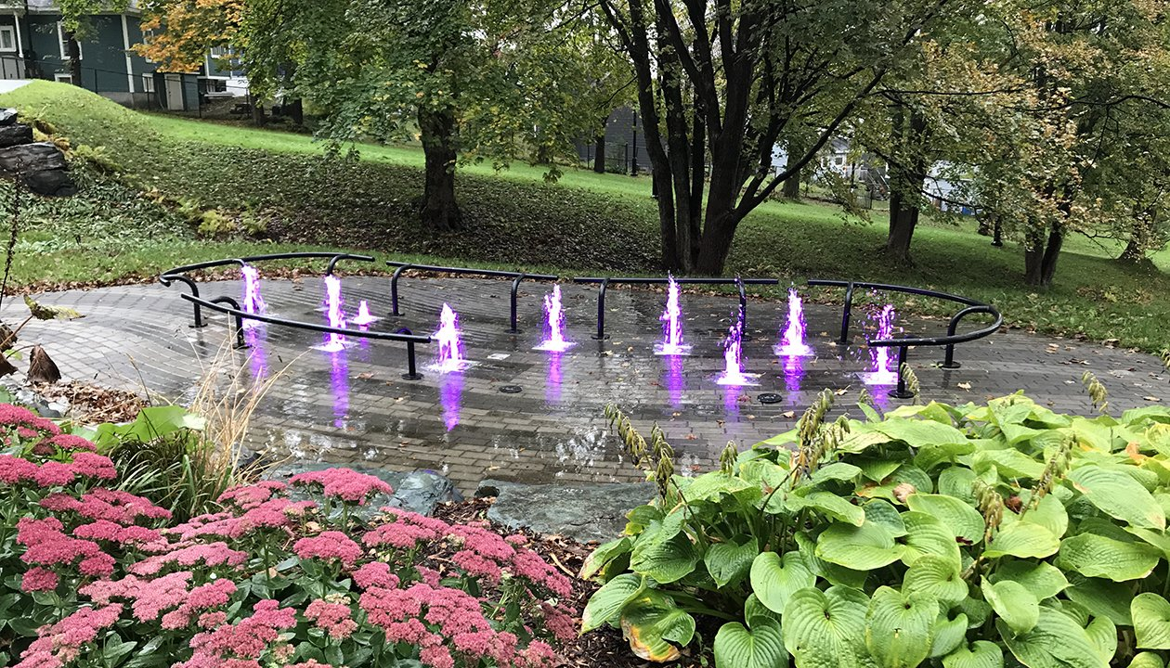
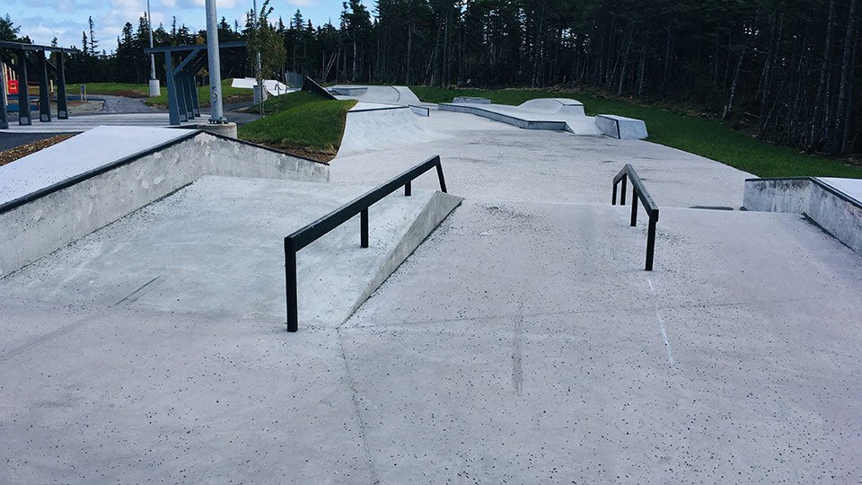
Parks, Trails, & Open Spaces
A CONNECTED CITY
The City of St. John’s maintains an extensive network of parks , sports facilities, open spaces, and trails.
Parks – small to large scale developed areas that contain a variety of amenities that service the needs of the public.
  Municipal parks: Bowring, Bannerman and Victoria
  Community parks: Kenmount, Southlands, Rotary, Larch, Goulds Complex, Bidgood Park
  Tot lots: Elks Club, Elm Pl., Taylor Pl., Wadland Cr., Penney Cr., Macbeth Dr
  Skateparks ie. Bowring, QV, Mundy Pond, Kenmount, Goulds, Shea Hts
Sports facilities – recreational facilities developed for softball, baseball, soccer, football, tennis, basketball, pickleball, lawn bowling, cricket
  Many of the facilities are located within municipal or community parks. The remainder are stand alone amenities.

Slide 4
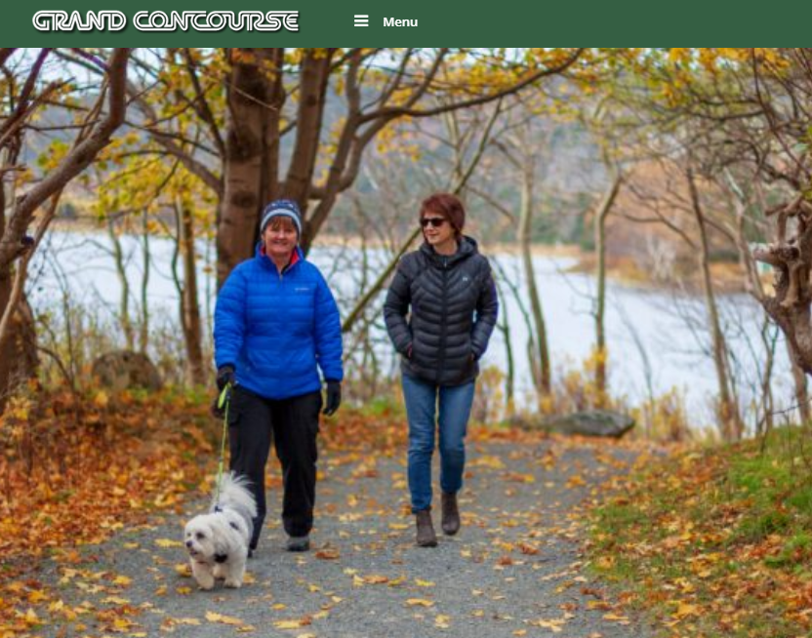
Parks, Trails, & Open Spaces
A CONNECTED CITY
Open Spaces – informal open or vegetated areas that support unstructured use and events; i.e., QV Lake, Cowan Park, areas adjacent to trails
Trails – extensive network of granular and paved trails traversing the City.
  Grand Concourse Walkway – approximately 125 km ; granular surface
  Bowring Park - 10+ Km; paved and granular surface
  Bidgood Park – 2500m ; granular surface
  Kenny’s Pond Park – 800m ; paved surface

Slide 5
Parks, Trails, & Open Spaces
A CONNECTED CITY
Maintenance of Parklands
Spring, summer, fall:
Collect litter and garbage, prune trees and shrubs, cut grass, maintain landscaped beds, plant trees, maintain trails, remove felled trees, address storm damage, remove tree hazards, mulch leaves etc, inspect and repair playgrounds
Winter:
Collect garbage from containers at trail heads, groom and track in trails at Bidgood Park, Southside Trail, Mundy Pond and Quidi Vidi Lake
Snow clear and provide ice control to paved walkway at Kenny’s Pond
Maintenance of Sports Facilities
Spring, summer, fall:
Mow, and trim grass, collect garbage and litter, install nets, lines, baskets, bases, pitching rubbers, home plates, prepare playing surfaces, grade parking lots etc.

Slide 6
Parks, Trails, & Open Spaces
A CONNECTED CITY
Parkland Development
The Parks and Open Spaces Division develops infrastructure based on the Open Space Master Plan.
Basis
  Constructed where people live.
  Neighbourhood parks serve immediate needs within 800m of a residence. As residential developments are built, these amenities are included.
  Community parks are constructed with a service radius of 1200m. They are placed where multiple neighbourhoods would fall within the service radius. They include a wide variety of amenities.

Slide 7
Parks, Trails, & Open Spaces
A CONNECTED CITY
Upcoming and Active Projects
Galway Community Park
Bidgood Park Wetland Walkway Replacement
City-wide Multi-use Trail
Enhanced Dog Park Lighting
Sports Facilities Enhancement for Canada Games
McNiven Pl. to Durness St. New Trail Construction
Disc Golf Course – Airport Heights
Installation of New Playground Equipment – various playgrounds

Slide 8
Arts & Culture
A CONNECTED CITY
What do we mean by Arts and Culture?
Not as easy to define as you might think!
Statistics Canada: “creative, artistic activity and the goods and services produced by it, and the preservation of heritage.”
Heritage and libraries
Live performance
Visual and applied arts
Written and published works
Audio-visual and interactive media
Sound recording

Slide 9
Arts & Culture
A CONNECTED CITY
What does the City currently do/maintain in the area of Arts and Culture?
Grants to local artists, arts organizations, and special events & festivals
City-hosted special events that feature and promote local artists
Arts & Culture Advisory Committee
Art Procurement
Public Art
Poet Laureate
Infrastructure

Slide 10
Arts & Culture
A CONNECTED CITY
Grants to local artists, arts organizations, and special events & festivals
Annual program providing financial support for:
  creative projects
  cultural programming
  cultural events

Slide 11
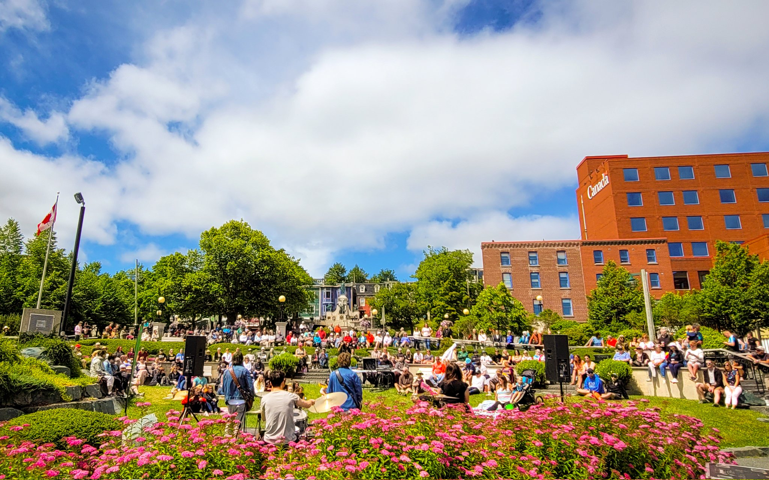
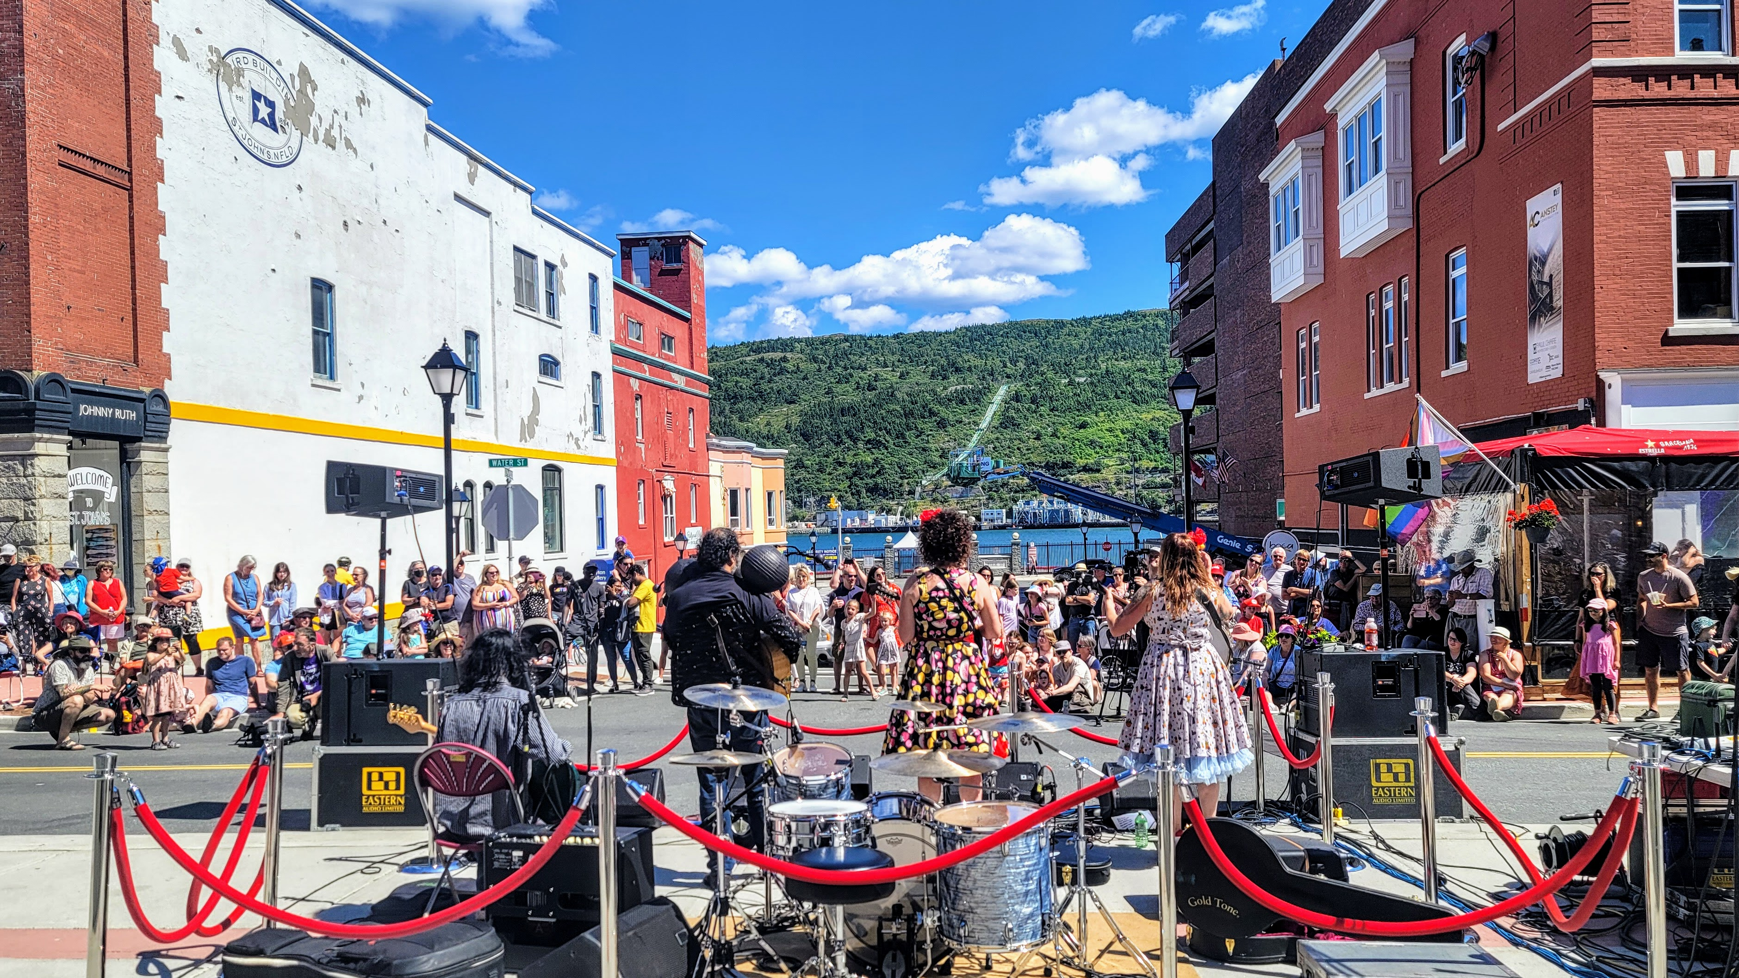
Arts & Culture
A CONNECTED CITY
City-hosted special events that feature and promote local artists
”Music @” Concert Series
Canada Day Concert
Festival of Music & Lights

Slide 12
Arts & Culture
A CONNECTED CITY
Arts & Culture Advisory Committee
Representation from different artistic disciplines, multicultural and Indigenous organizations, City Council, and City staff.
Providing information and advice to Council on matters related to arts, culture and intangible cultural heritage.

Slide 13
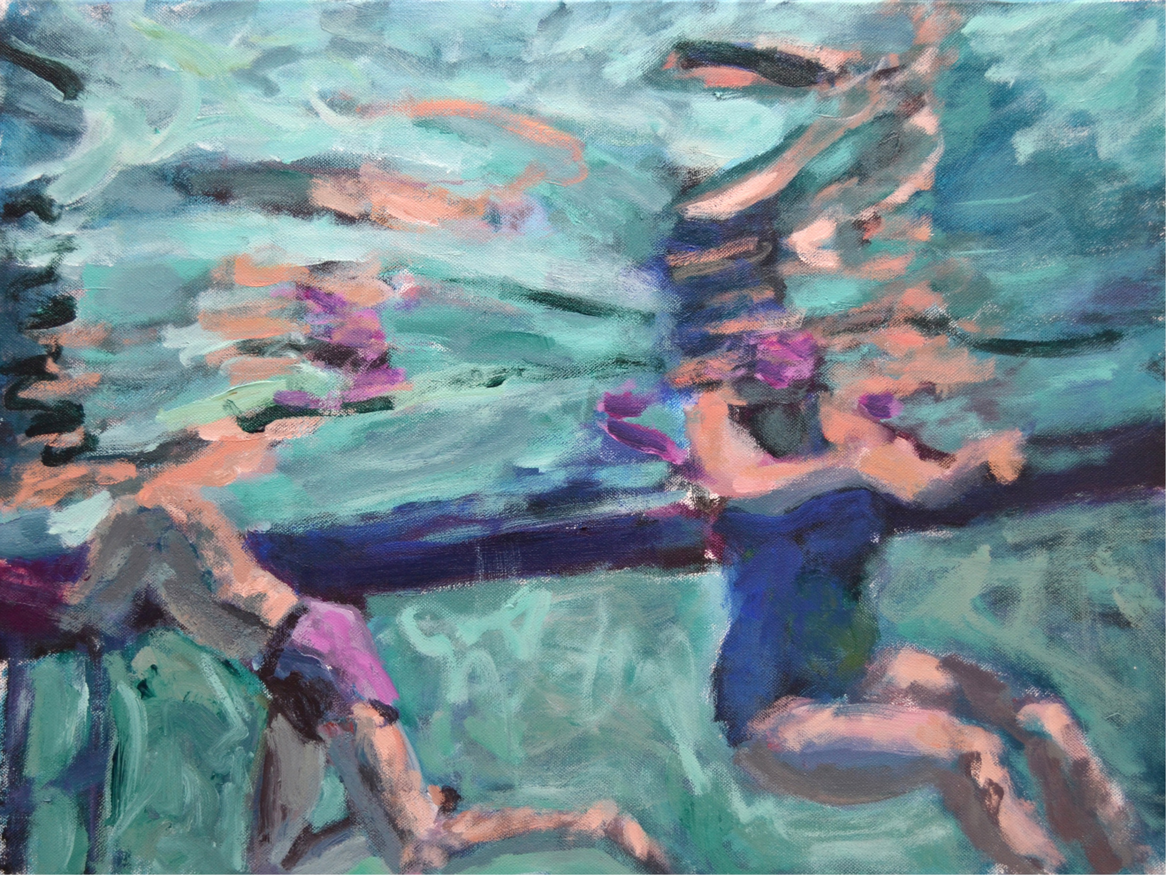
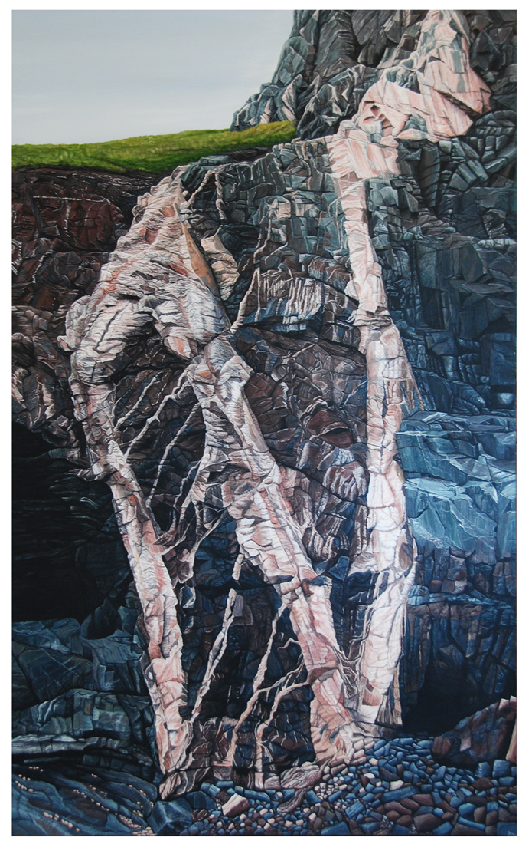
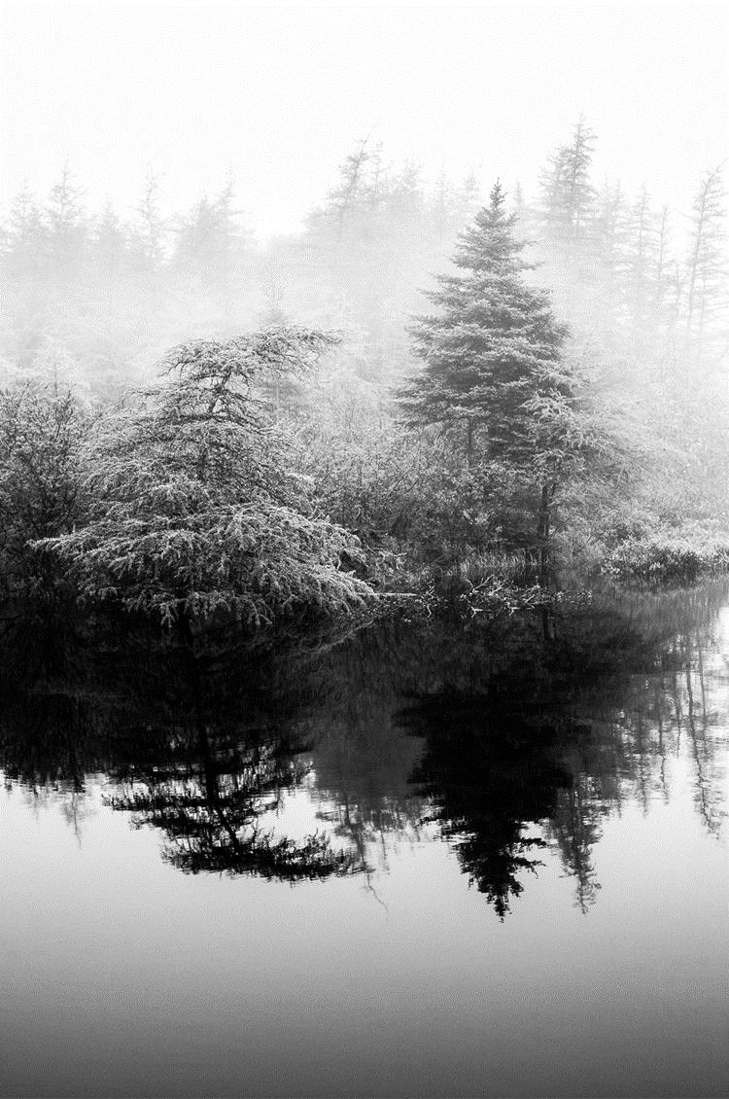
Arts & Culture
A CONNECTED CITY
Art Procurement
Annual program through which the City purchases artwork
Artwork is displayed throughout City Hall and other City buildings
Budget of $20,000
Submissions from art galleries and individual artists
See the artwork purchased in 2021 and 2020 on the City’s website
Clockwise from top left: John MacCallum, Joanne Cole, Malin Enström.

Slide 14
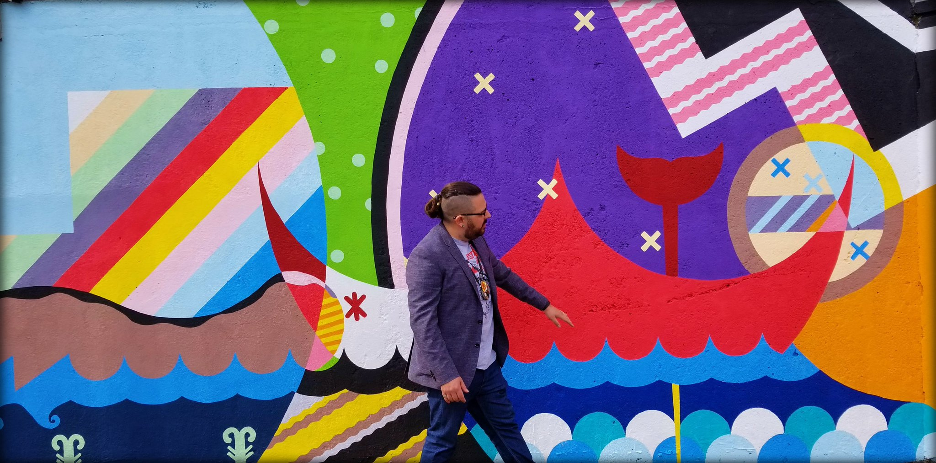
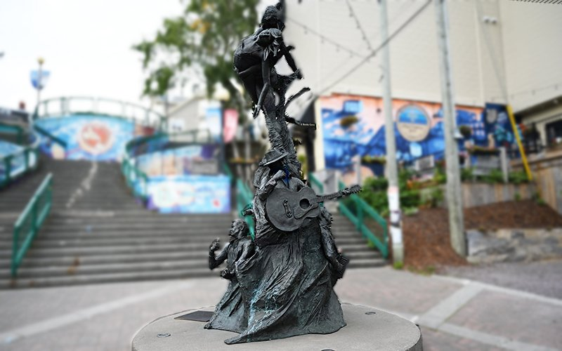
Arts & Culture
A CONNECTED CITY
Public Art
Mural Program
Sculpture

Slide 15
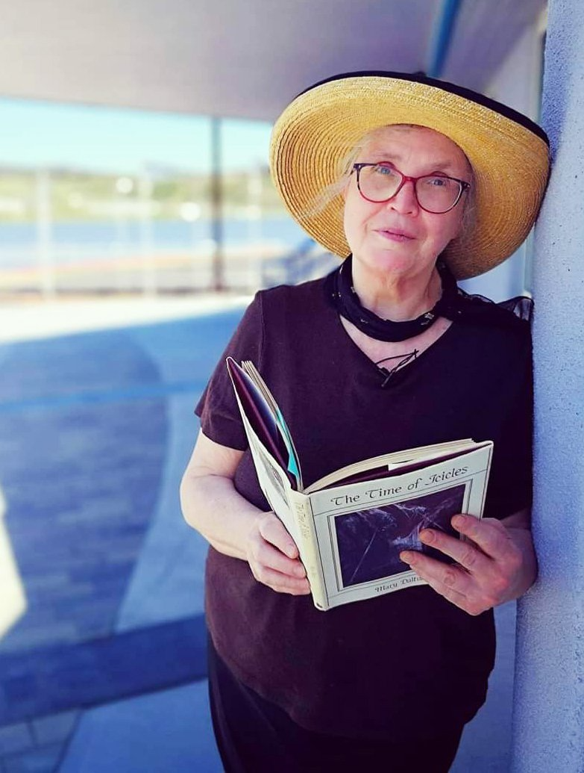
Arts & Culture
A CONNECTED CITY
Arts & Culture
Poet Laureate
An honorary position appointed by City Council
The Poet Laureate serves as an ambassador for poetry. They integrate poetry into a range of official and unofficial civic events.
Our current Poet Laureate is Mary Dalton
Past Poets Laureate: George Murray, Tom Dawe, Agnes Walsh

Slide 16
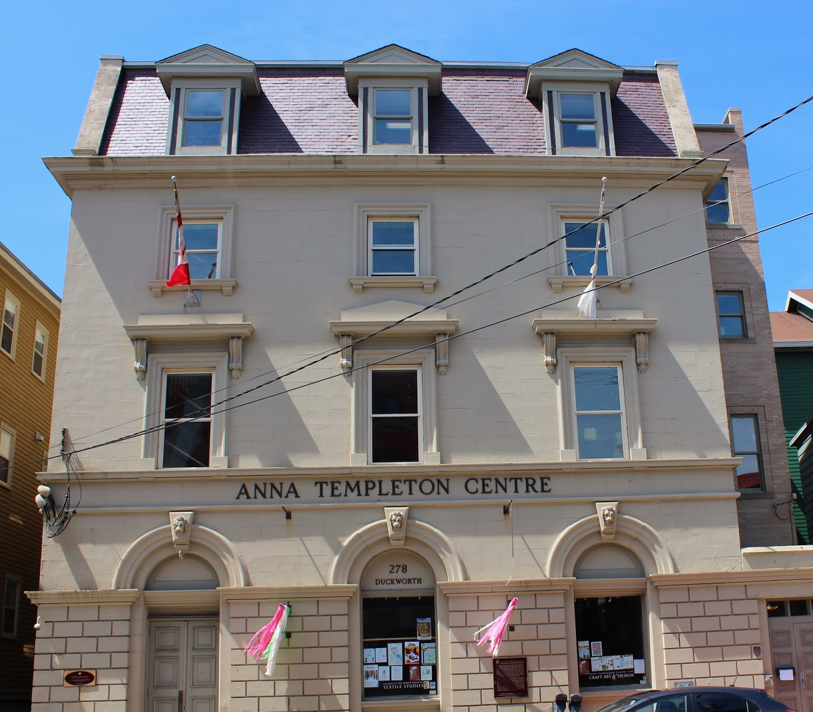
Arts & Culture
A CONNECTED CITY
Arts & Culture
Infrastructure
Anna Templeton Centre
Quidi Vidi Village Artisan Studios

Slide 17
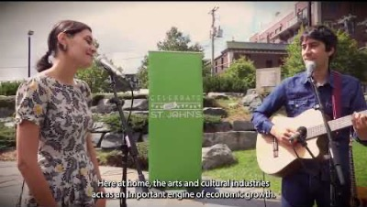
Arts & Culture
A CONNECTED CITY
What plans does the City have related to Arts and Culture – big projects or initiatives in the works?
Municipal Arts Plan Review
Creative City Summit 2023

Slide 18
Active Transportation
A CITY THAT MOVES
What do we mean by “Active Transportation”?
People walking, biking, running, strolling, wheeling, scooting, skateboarding, and more!

Slide 19
Active Transportation
A CITY THAT MOVES
What does the City currently do/maintain in the area of Active Transportation?
Transportation Planning & Engineering
Develop plans and policies (Mode Share Targets, Bike Master Plan, Development Design Manual)
Design and build bike lanes, sidewalks, shared-use paths
Communications and public engagement
Traffic calming & road safety initiatives
Development plan review for new buildings and subdivisions
Downtown pedestrian mall and parklet program
Sidewalk infill program
And more!
Operations
Snow clearing and annual maintenance
Street closures

Slide 20
Active Transportation
A CITY THAT MOVES
What plans does the City have related to Active Transportation – big projects or initiatives in the works?
Kelly’s Brook shared-use path
Canada Drive active transportation and safety upgrades
Elizabeth Avenue Canada Games Upgrades
And more to follow in the works… Columbus Drive shared-use path “Crosstown Trail” missing links, wayfinding and pavement marking upgrades for T’railway and Crosstown trail, bike rack installations, more bike routes, etc.

Slide 21
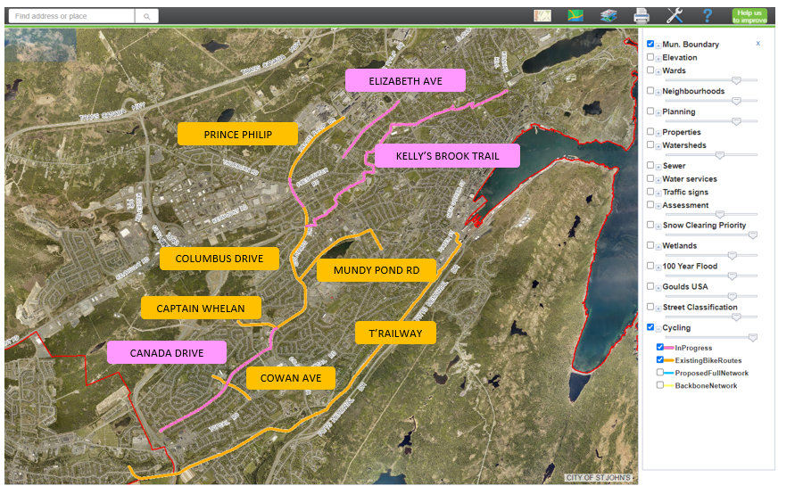
Active Transportation
A CITY THAT MOVES

Slide 22
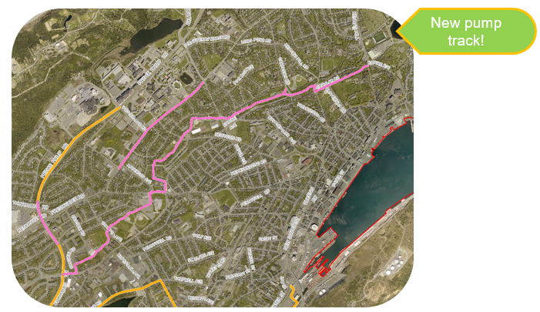
Active Transportation
A CITY THAT MOVES
Kelly’s Brook Shared-Use Path
First project from the Bike Master Plan
Design is almost complete
Construction to begin 2023

Slide 23
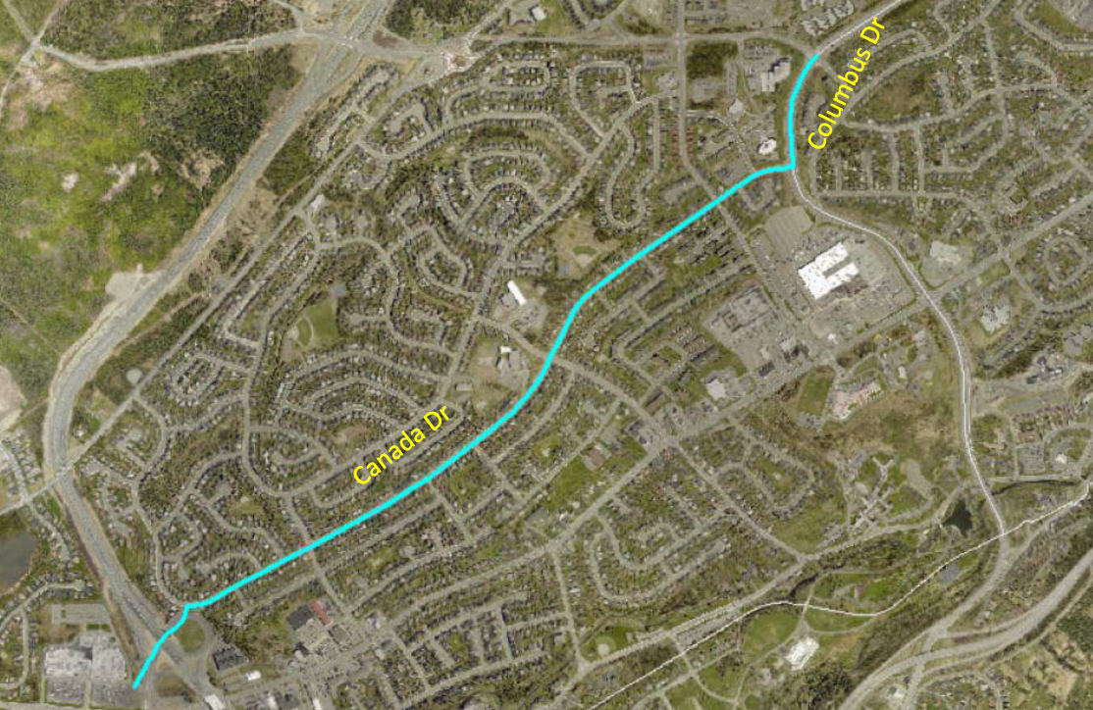
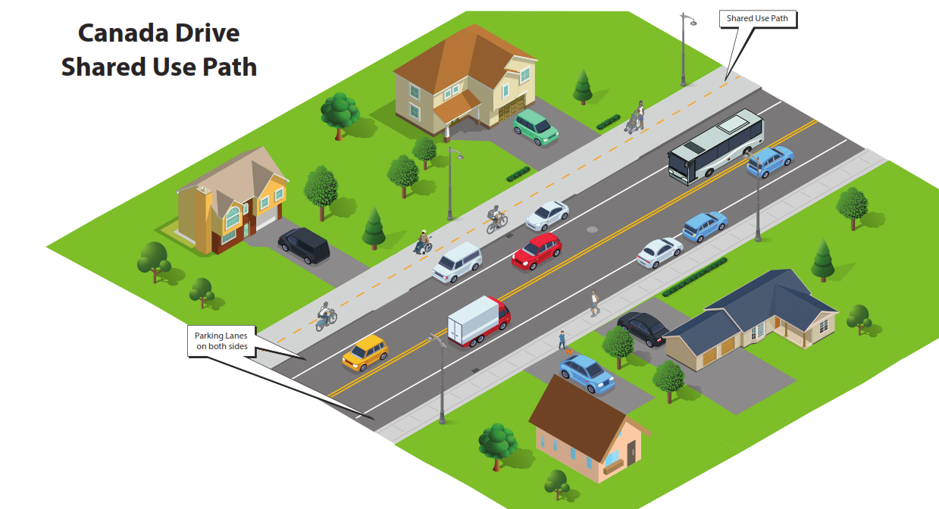
Active Transportation
A CITY THAT MOVES
Canada Drive Active Transportation Improvements

Slide 24
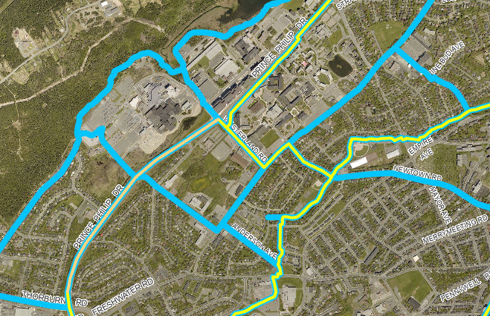
Active Transportation
A CITY THAT MOVES
Elizabeth Ave Canada Games Upgrades

